Slide 1


Tampering Detection in Low-Power Smart Cameras
Adriano Gaibotti, Claudio Marchisio,
Alexandro Sentinelli, Giacomo Boracchi
ST Microelectronics (AST), Agrate Brianza (MB), Italy
Politecnico di Milano (DEIB), Milano (MI), Italy

Slide 2
Motivation
Scenario: video monitoring systems operating outdoor and in harsh environments
Tampering Detection: automatic identification of events that could prevent the correct image acquisition
Camera sabotage
Natural phenomena (wind, rain drops, snow…)
Degradations on images:
Change of the camera view-point
Blurring artefacts
which causes a substantial loss of information
Notes:
Rain, snow, dust lying on the camera lens cause blurry or partially occluded pictures, while wind might displace the camera. Similarly, an attacker can intentionally change the camera focus, spray some opaque or glossy liquid, displace or occlude the camera.

Slide 3
Motivation
Scenario: video monitoring systems operating outdoor and in harsh environments
Tampering Detection: automatic identification of events that could prevent the correct image acquisition
Camera sabotage
Natural phenomena (wind, rain drops, snow…)
Degradations on images:
Change of the camera view-point
Blurring artefacts
which causes a substantial loss of information
Notes:
Lo scenario che consideriamo in questa tesi è quello dei sistemi di monitoraggio video.
In particolare ci siamo concentrati sul problema di identificare particolari eventi in grado di compromettere la corretta ripresa della scena.
Questi particolari eventi prendono il nome di tampering

Slide 4
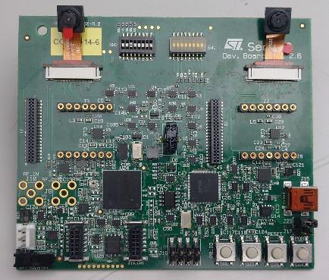
Our Goal
Low-power smart cameras should be able to autonomously detect tampering events to activate suitable countermeasures
Idea: perform tampering detection by solely monitoring the video stream acquired form a low-powered device
Target Device: SecSoc (Security System on Chip)
Two AA batteries
Simple Imaging analytics tasks
In case of event detection
Send “event detected” message
Transfer compressed images sequence (mjpeg)
Challenges:
Computational constraints
Very low frame rates (e.g, < 1 frame per minute)
Notes:
Device target: SecSoc (Security System on Chip)
ReISC (Reduced Energy Instruction Set Computer)
Clock rates:
82.5 MHz at 1.2V
Sub-1MHz at 0.6V
Reduced memory (1.25 MB)
Battery-powered

Slide 5
Our Goal
Low-power smart cameras should be able to autonomously detect tampering events to activate suitable countermeasures
Idea: perform tampering detection by solely monitoring the video stream acquired form a low-powered device
Target Device: SecSoc (Security System on Chip)
Two AA batteries
Simple Imaging analytics tasks
In case of event detection
Send “event detected” message
Transfer compressed images sequence (mjpeg)
Notes:
Device target: SecSoc (Security System on Chip)
ReISC (Reduced Energy Instruction Set Computer)
Clock rates:
82.5 MHz at 1.2V
Sub-1MHz at 0.6V
Reduced memory (1.25 MB)
Battery-powered

Slide 6
Challenges
In a low-power smart camera, tampering detection is more challenging because:
Computational constraints
Very low frame rates (e.g, < 1 frame per minute)
Even in normal conditions, the scene content might change much in between two frames

Slide 7
Problem formulation

Slide 8
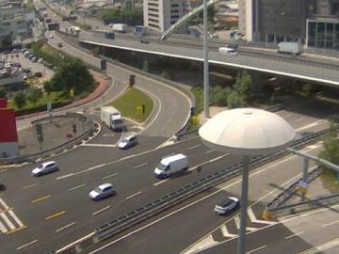
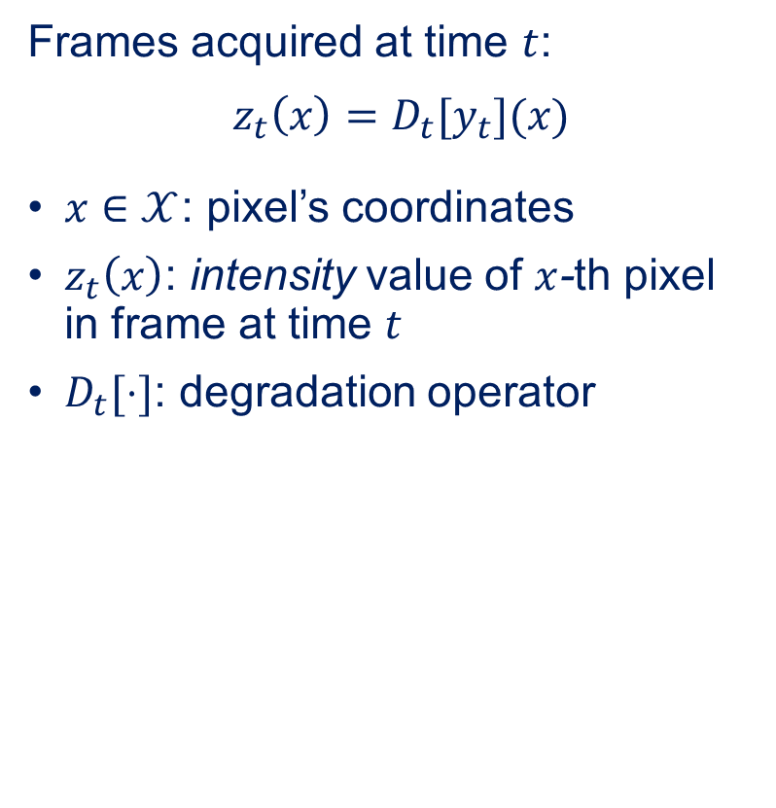
Problem Formulation
Frames acquired at time $t$:
$$z_{t}\left(x\right)=D_{t}[y_{t}](x)$$
$x∈𝒳$: pixel’s coordinates
$z_{t}\left(x\right)$: intensity value of $x$-th pixel in frame at time $t$
$D_{t}[⋅]$: degradation operator

Slide 9
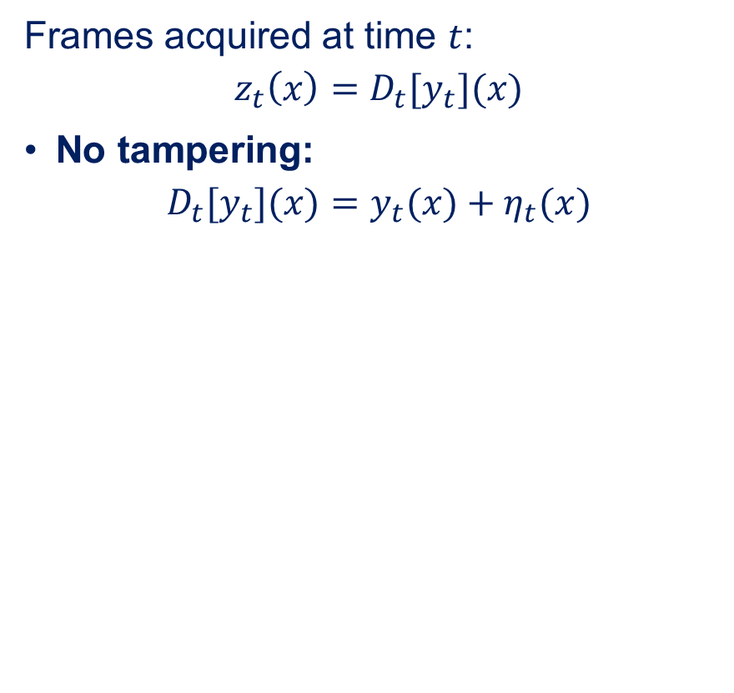
Problem Formulation
Frames acquired at time $t$:
$$z_{t}\left(x\right)=D_{t}[y_{t}](x)$$
No tampering:
$$D_{t}[y_{t}](x)=y_{t}(x)+η_{t}(x)$$

Slide 10
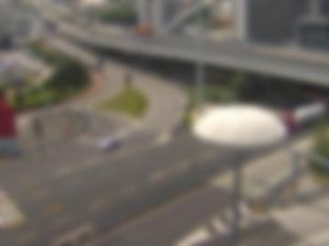
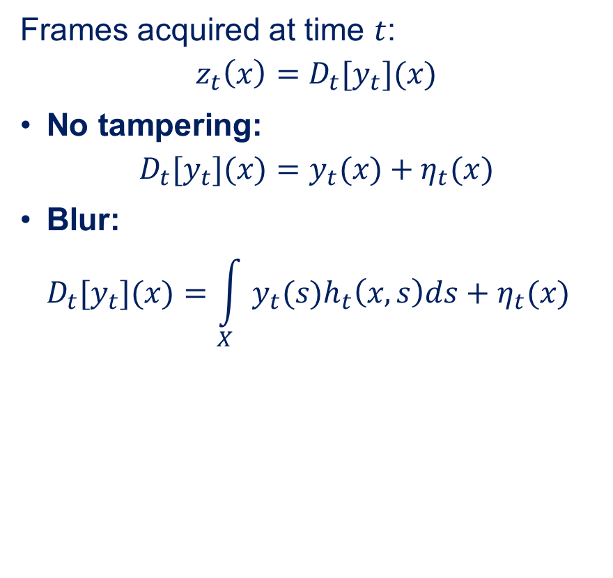
Problem Formulation
Frames acquired at time $t$:
$$z_{t}\left(x\right)=D_{t}[y_{t}](x)$$
No tampering:
$$D_{t}[y_{t}](x)=y_{t}(x)+η_{t}(x)$$
Blur: $D_{t}[y_{t}](x)=\int_{X}{y_{t}(s)h_{t}\left(x,s\right)ds}+η_{t}(x)$

Slide 11
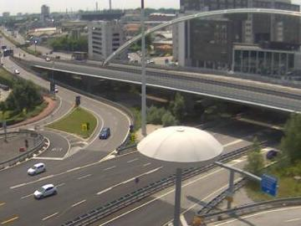
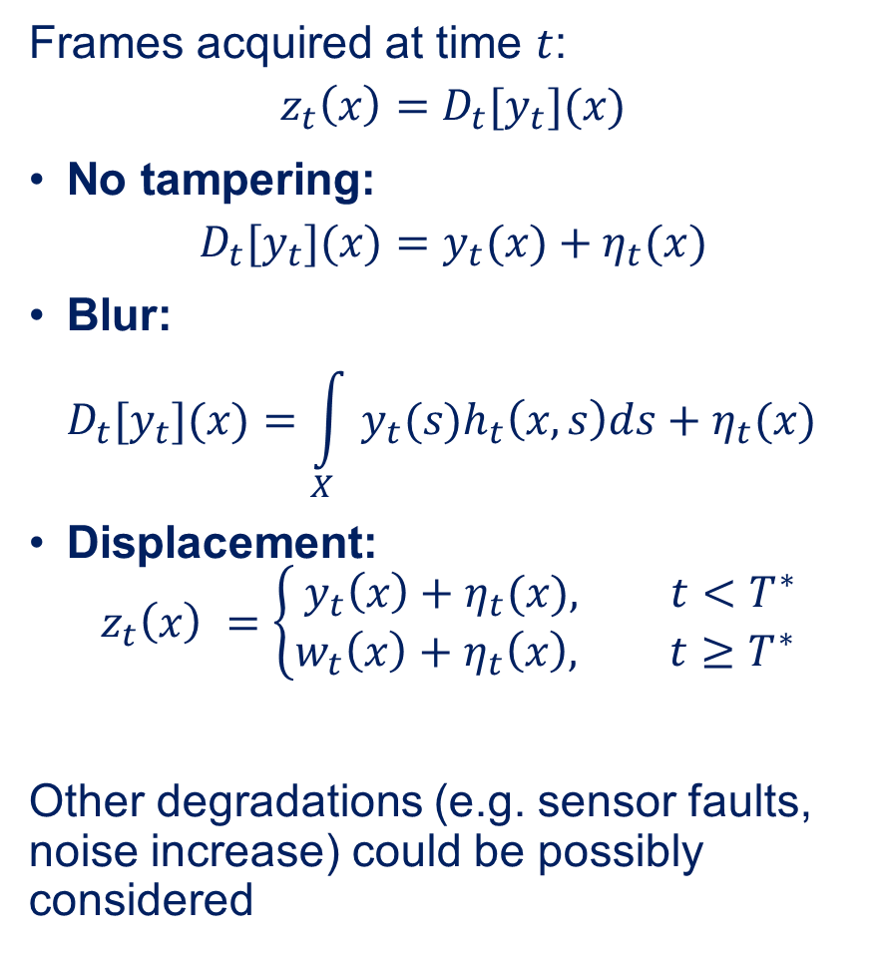
Problem Formulation
Frames acquired at time $t$:
$$z_{t}\left(x\right)=D_{t}[y_{t}](x)$$
No tampering:
$$D_{t}[y_{t}](x)=y_{t}(x)+η_{t}(x)$$
Blur: $D_{t}[y_{t}](x)=\int_{X}{y_{t}(s)h_{t}\left(x,s\right)ds}+η_{t}(x)$
Displacement: $z_{t}\left(x\right) =\left\{\begin{aligned}y_{t}\left(x\right)+η_{t}(x), t<T^{∗} \\ &w_{t}\left(x\right)+η_{t}\left(x\right), t≥T^{∗} \end{aligned}\right.$
Other degradations (e.g. sensor faults, noise increase) could be possibly considered

Slide 12
Proposed solution

Slide 13
Proposed Solution
Our solution three features:
Extract scalar indicators from each frame, that should:
Have low computational cost
Have low memory requirements
Detect outliers in the indicators to identify tampering events
Segment the scene and monitor each region
Definition of regions in which indicators are stationary
Analysis of the indicators separately for each region
Combining together the obtained results
Notes:
Per migliorare le performance abbiamo introdotto una fase di segmentazione in maniera tale che i nostri indicatori si comportino in maniera stazionaria.

Slide 14
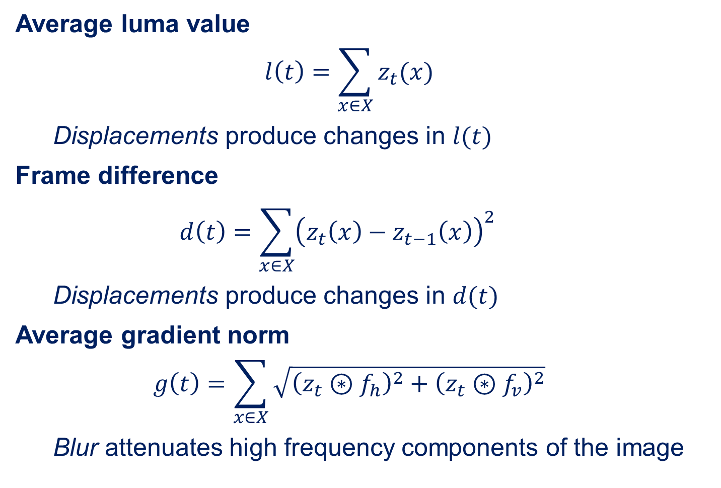
Extracted indicators
Average luma value
$$l\left(t\right)=\sum_{x∈X}{z_{t}(x)}$$
Displacements produce changes in $l(t)$
Frame difference
$$d\left(t\right)={\sum_{x∈X}{{\left(z_{t}\left(x\right)−z_{t−1}\left(x\right)\right)}^{2} }}^{}$$
Displacements produce changes in $d(t)$
Average gradient norm
$$g\left(t\right)=\sum_{x∈X}{\sqrt{{\left(z_{t}⊛f_{h}\right)}^{2}+{\left(z_{t}⊛f_{v}\right)}^{2}}}$$
Blur attenuates high frequency components of the image
Notes:
Non modellabile con modelli predittivi

Slide 15
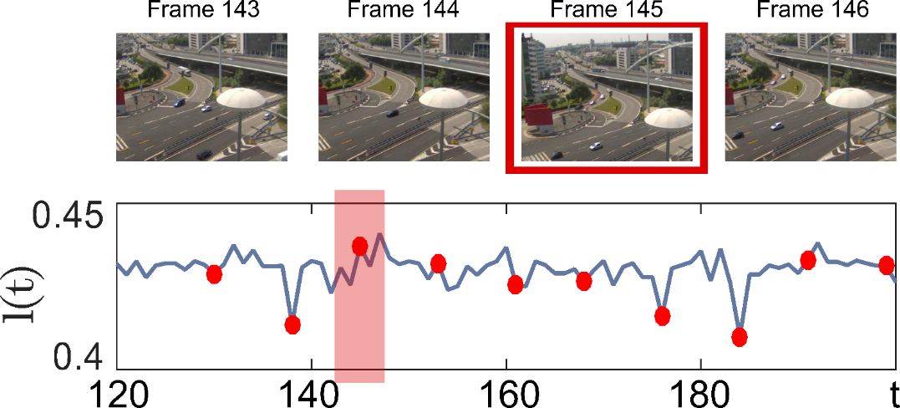
Example: camera displacements

Slide 16
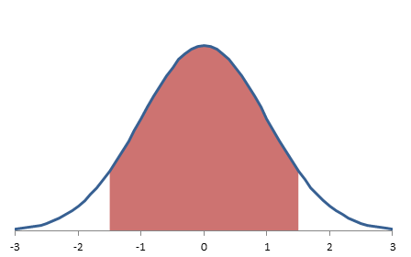
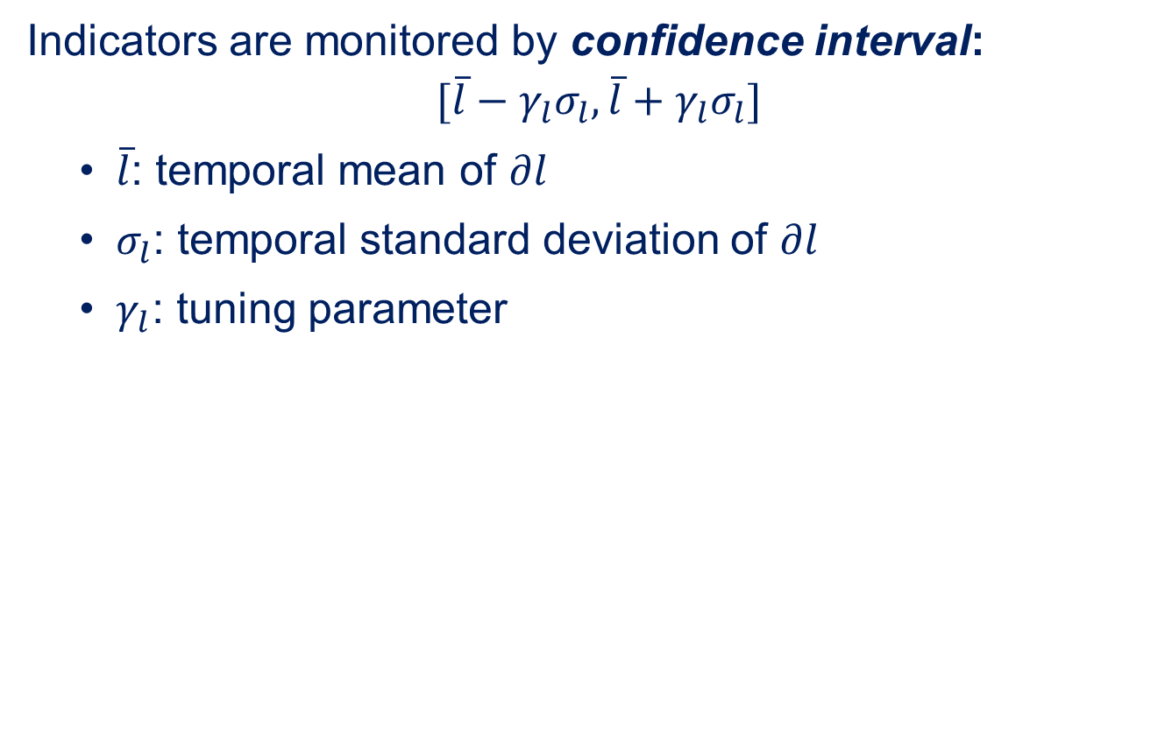
Outlier detection
Indicators are monitored by confidence interval:
$$[\overline{l}−γ_{l}σ_{l},\overline{l}+γ_{l}σ_{l}]$$
$\overline{l}$: temporal mean of $∂l$
$σ_{l}$: temporal standard deviation of $∂l$
$γ_{l}$: tuning parameter

Slide 17
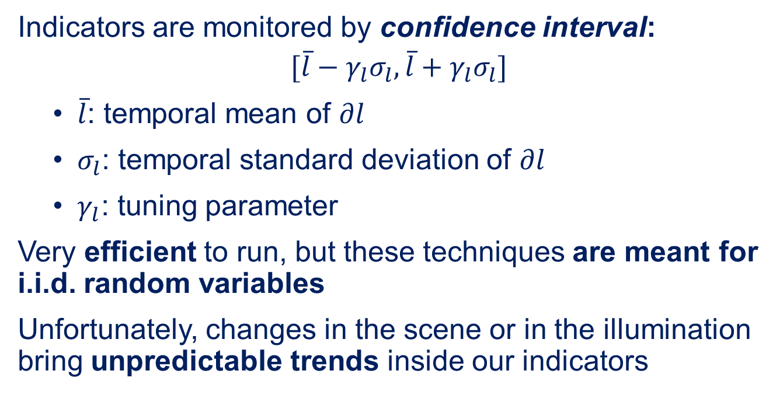
Outlier detection
Indicators are monitored by confidence interval:
$$[\overline{l}−γ_{l}σ_{l},\overline{l}+γ_{l}σ_{l}]$$
$\overline{l}$: temporal mean of $∂l$
$σ_{l}$: temporal standard deviation of $∂l$
$γ_{l}$: tuning parameter
Very efficient to run, but these techniques are meant for i.i.d. random variables
Unfortunately, changes in the scene or in the illumination bring unpredictable trends inside our indicators

Slide 18
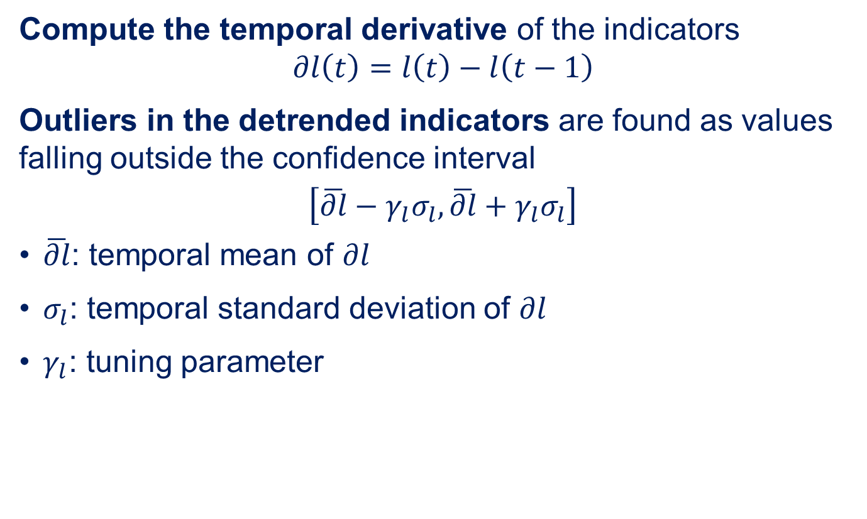
Detrending
Compute the temporal derivative of the indicators $$∂l\left(t\right)=l\left(t\right)−l\left(t−1\right)$$
Outliers in the detrended indicators are found as values falling outside the confidence interval
$$\left[\overline{∂l}−γ_{l}σ_{l},\overline{∂l}+γ_{l}σ_{l}\right]$$
$\overline{∂l}$: temporal mean of $∂l$
$σ_{l}$: temporal standard deviation of $∂l$
$γ_{l}$: tuning parameter
Notes:
Al max un livello elenco puntato
Formule in centro

Slide 19
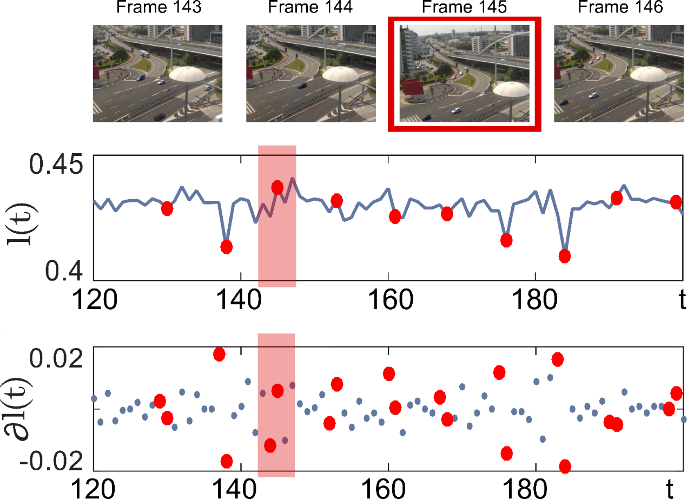
Example: camera displacements

Slide 20

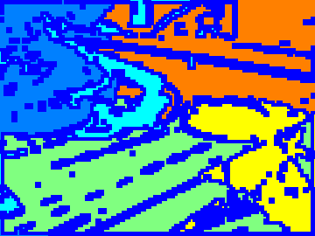
Segmentation
Video parts with different degrees of texture and dynamics
Indicators applied in different areas of the image have different behaviours
Static and high textured
Static and low textured
High dynamics

Slide 21
Segmentation
Video parts with different degrees of texture and dynamics
Indicators applied in different areas of the image have different behaviours
An adaptive segmentation of the image is able to make the tampering detection more robust.
Static and high textured
Static and low textured
High dynamics

Slide 22
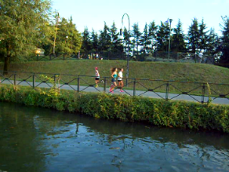
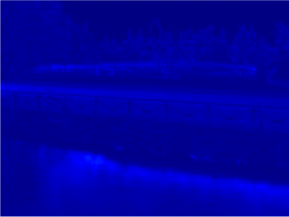

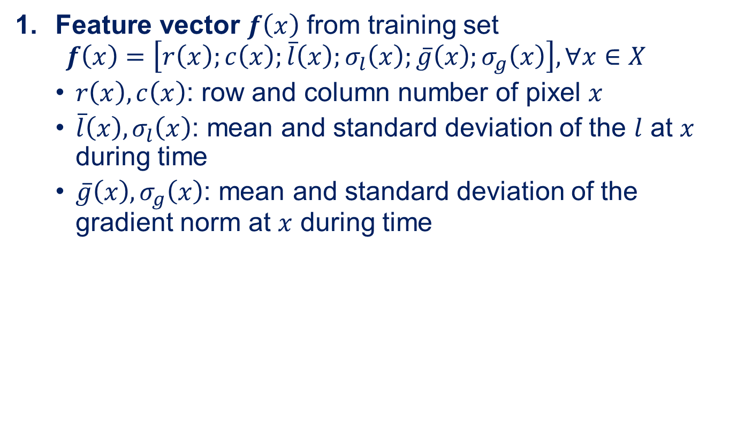
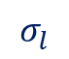

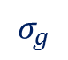
Segmentation
Feature vector $f\left(x\right)$ from training set
$$f\left(x\right)=\left[r\left(x\right);c\left(x\right);\overline{l}\left(x\right);σ_{l}\left(x\right);\overline{g}\left(x\right);σ_{g}\left(x\right)\right], ∀x∈X$$
$r\left(x\right),c\left(x\right)$: row and column number of pixel $x$
$\overline{l}\left(x\right), σ_{l}\left(x\right)$: mean and standard deviation of the $l$ at $x$ during time
$\overline{g}\left(x\right), σ_{g}\left(x\right)$: mean and standard deviation of the gradient norm at $x$ during time
$$\overline{l}$$
$$\overline{g}$$
$$σ_{l}$$
$$σ_{g}$$
Notes:
Qui il top sarebbe unire questa slide e la seguente,
Mettendo sopra lo step (numerandioli 1 –feature veector, 2 k-means, 3 morpho) e sotto l’immagine della slide sequente che mostra il processo
Qui fai la media sia spaziale che temporale, giusto?

Slide 23
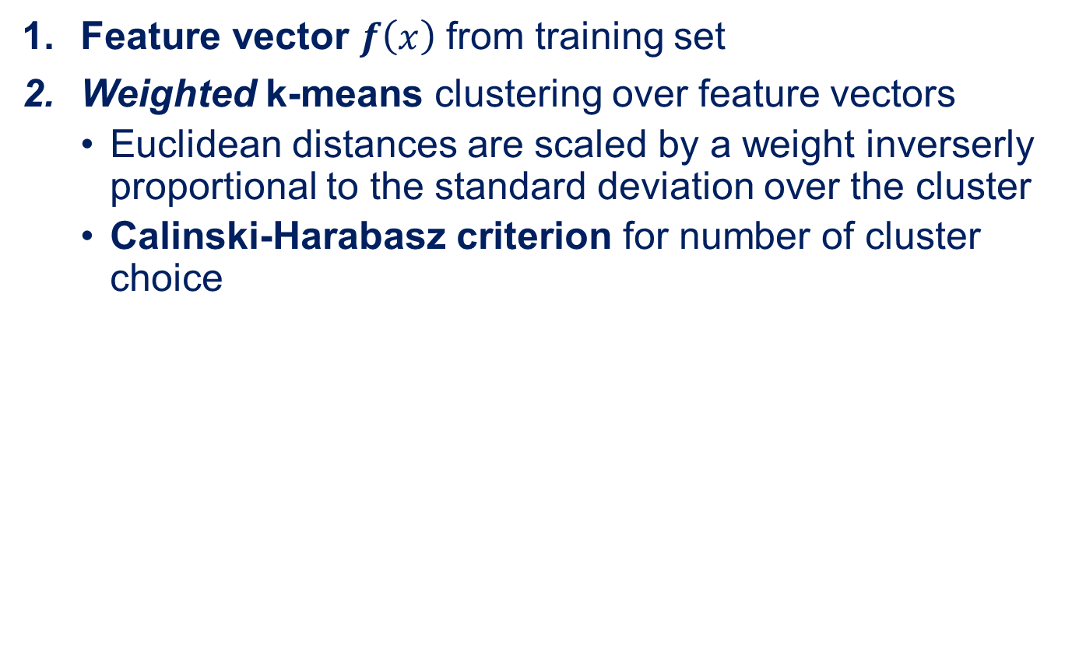
Segmentation
Feature vector $f\left(x\right)$ from training set
Weighted k-means clustering over feature vectors
Euclidean distances are scaled by a weight inverserly proportional to the standard deviation over the cluster
Calinski-Harabasz criterion for number of cluster choice
$$\overline{l}$$
$$\overline{g}$$
$$σ_{l}$$
$$σ_{g}$$
Notes:
Qui il top sarebbe unire questa slide e la seguente,
Mettendo sopra lo step (numerandioli 1 –feature veector, 2 k-means, 3 morpho) e sotto l’immagine della slide sequente che mostra il processo
Qui fai la media sia spaziale che temporale, giusto?

Slide 24
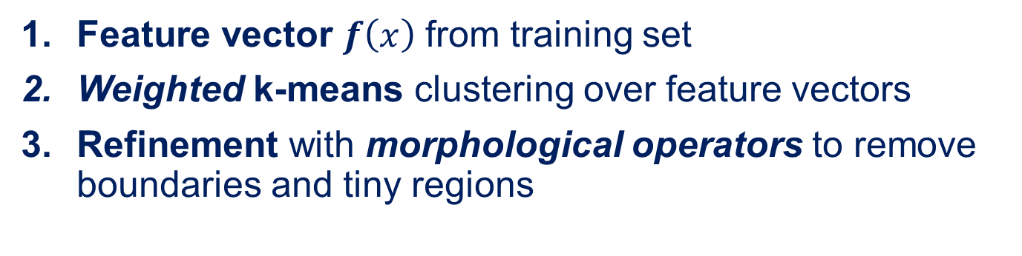
Segmentation
Feature vector $f\left(x\right)$ from training set
Weighted k-means clustering over feature vectors
Refinement with morphological operators to remove boundaries and tiny regions
$$\overline{l}$$
$$\overline{g}$$
$$σ_{l}$$
$$σ_{g}$$
Notes:
Qui il top sarebbe unire questa slide e la seguente,
Mettendo sopra lo step (numerandioli 1 –feature veector, 2 k-means, 3 morpho) e sotto l’immagine della slide sequente che mostra il processo
Qui fai la media sia spaziale che temporale, giusto?

Slide 25
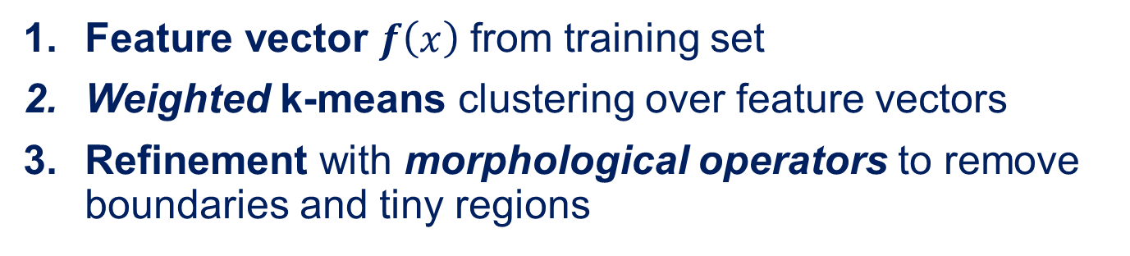
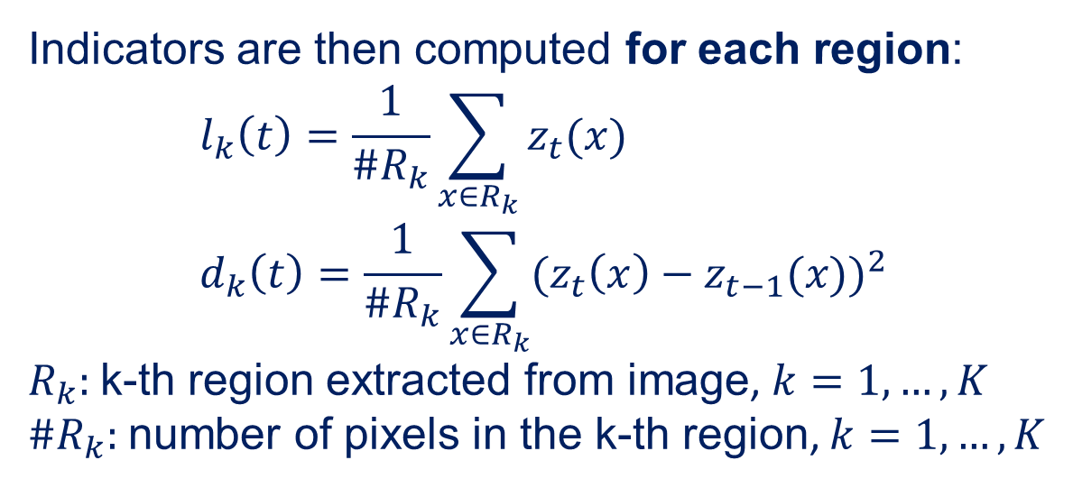
Segmentation
Feature vector $f\left(x\right)$ from training set
Weighted k-means clustering over feature vectors
Refinement with morphological operators to remove boundaries and tiny regions
Indicators are then computed for each region: $$l_{k}\left(t\right)=\frac{1}{\#R_{k}}\sum_{x∈R_{k}}{z_{t}(x)} \\ d_{k}\left(t\right)=\frac{1}{\#R_{k}}\sum_{x∈R_{k}}{{{(z}_{t}\left(x\right)−z_{t−1}(x))}^{2}}$$ $R_{k}:$k-th region extracted from image, $k=1,…,K$
${\#R}_{k}:$number of pixels in the k-th region, $k=1,…,K$
Notes:
Qui il top sarebbe unire questa slide e la seguente,
Mettendo sopra lo step (numerandioli 1 –feature veector, 2 k-means, 3 morpho) e sotto l’immagine della slide sequente che mostra il processo
Qui fai la media sia spaziale che temporale, giusto?

Slide 26

Example: camera displacements

Slide 27
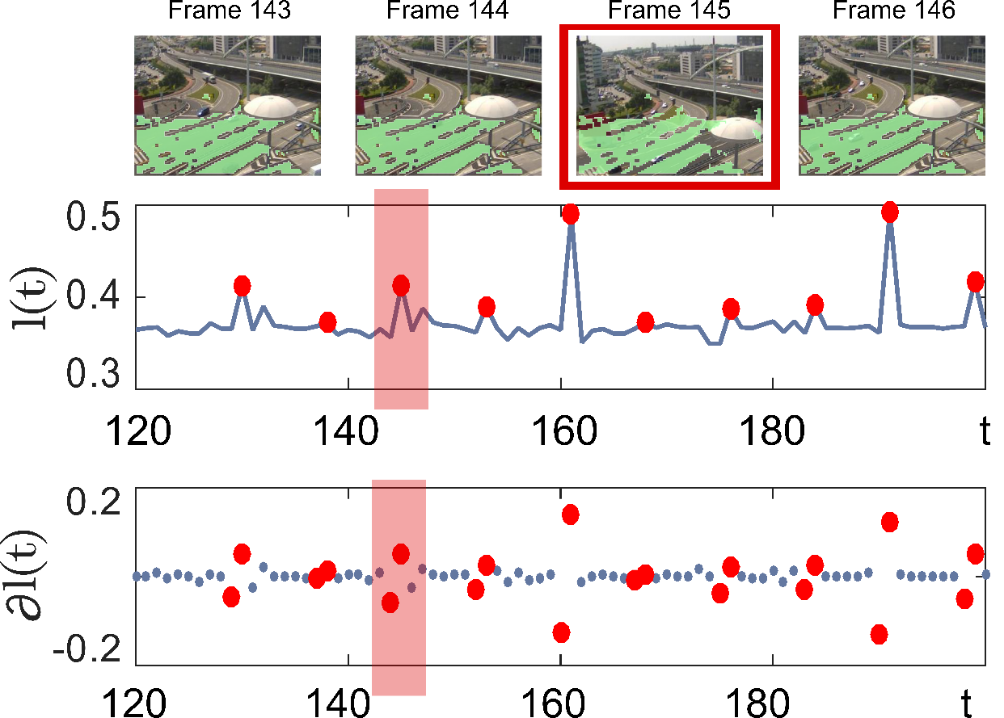
Example: camera displacements

Slide 28
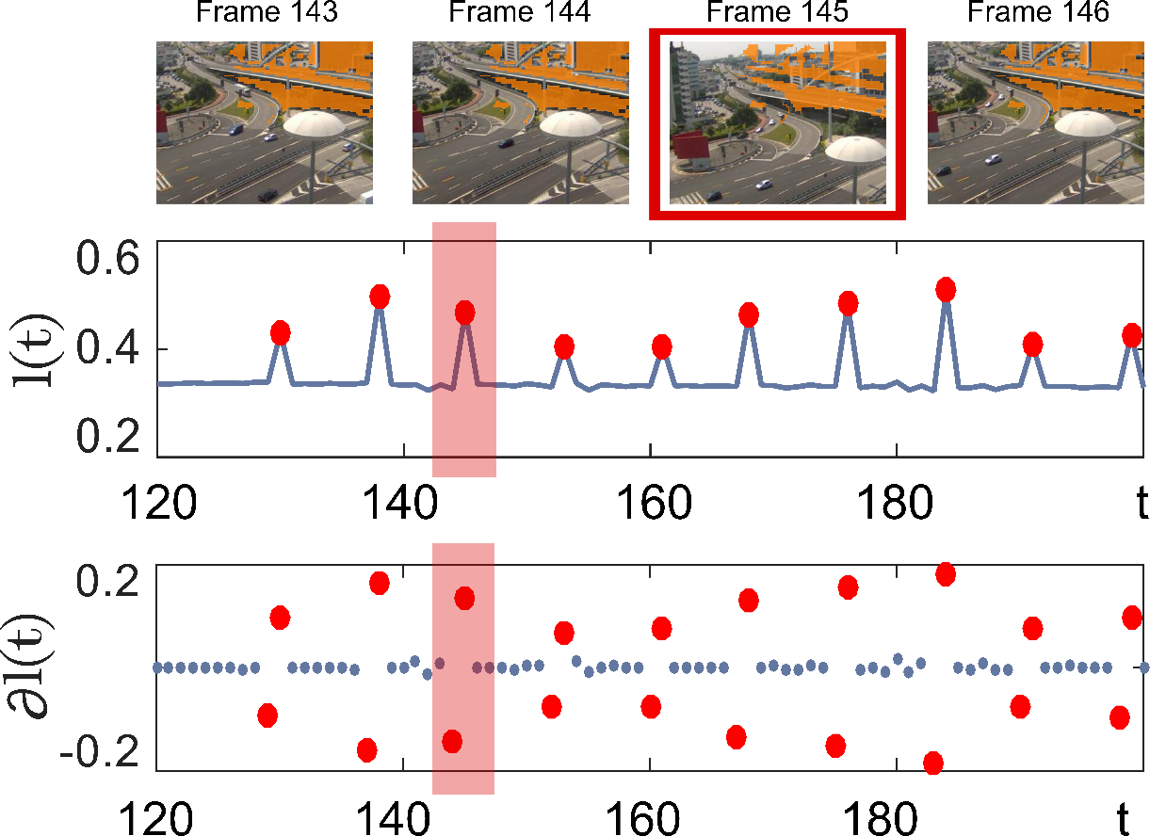
Example: camera displacements

Slide 29

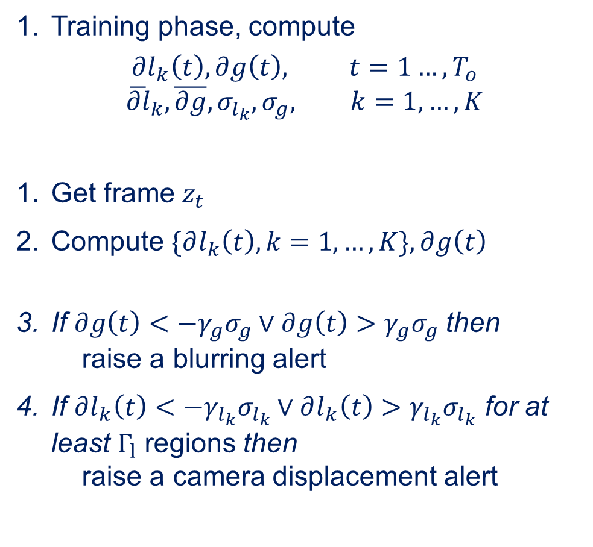
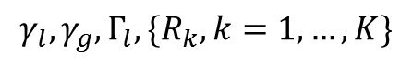
Algorithm
Training phase, compute
$$∂l_{k}\left(t\right), ∂g\left(t\right), t=1…,T_{o}$$
$${\overline{∂l}}_{k},\overline{∂g},σ_{l_{k}}, σ_{g}, k=1,…,K$$
Get frame $z_{t}$
Compute $\{∂l_{k}\left(t\right), k=1,…,K\},∂g\left(t\right)$
If $∂g\left(t\right)<−γ_{g}σ_{g}∨∂g\left(t\right)>γ_{g}σ_{g}$then raise a blurring alert
If $∂l_{k}\left(t\right)<−γ_{l_{k}}σ_{l_{k}}∨∂l_{k}\left(t\right)>γ_{l_{k}}σ_{l_{k}}$ for at least $Γ_{l}$ regions then raise a camera displacement alert
INPUT:
Training frames,
$$γ_{l}, γ_{g}, Γ_{l},{\{R}_{k},k=1,…,K\}$$
Training phase
Operational phase
Detect?
no
yes

Slide 30
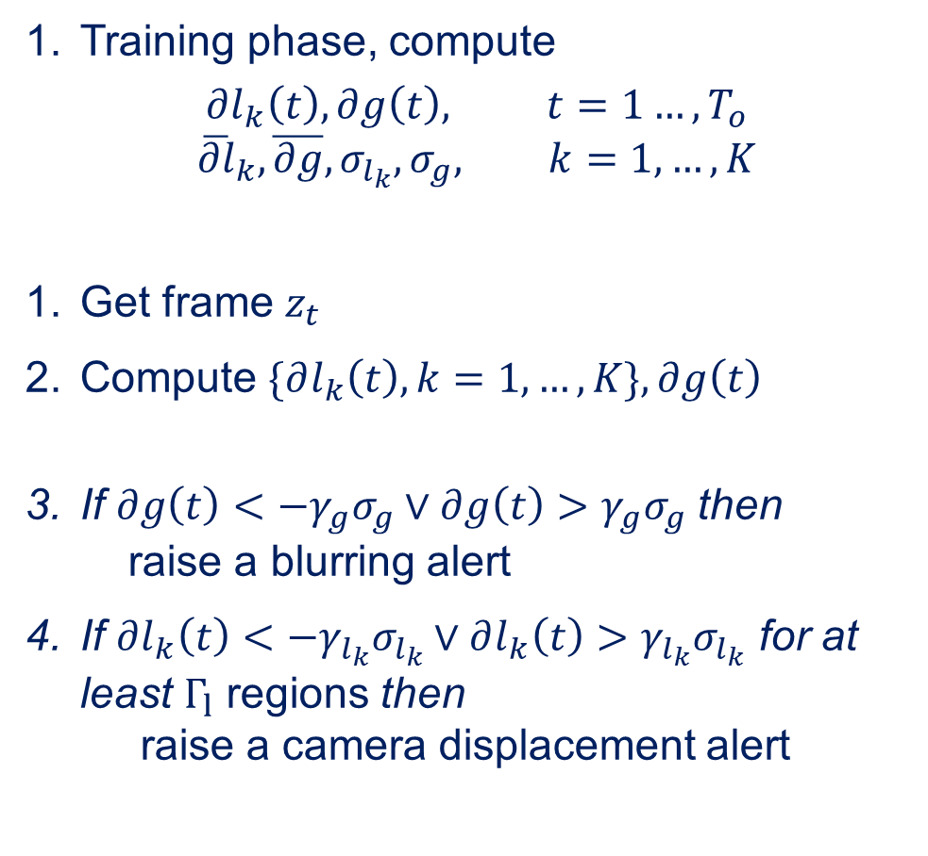
Algorithm
Training phase, compute
$$∂l_{k}\left(t\right), ∂g\left(t\right), t=1…,T_{o}$$
$${\overline{∂l}}_{k},\overline{∂g},σ_{l_{k}}, σ_{g}, k=1,…,K$$
Get frame $z_{t}$
Compute $\{∂l_{k}\left(t\right), k=1,…,K\},∂g\left(t\right)$
If $∂g\left(t\right)<−γ_{g}σ_{g}∨∂g\left(t\right)>γ_{g}σ_{g}$then raise a blurring alert
If $∂l_{k}\left(t\right)<−γ_{l_{k}}σ_{l_{k}}∨∂l_{k}\left(t\right)>γ_{l_{k}}σ_{l_{k}}$ for at least $Γ_{l}$ regions then raise a camera displacement alert
INPUT:
Training frames,
$$γ_{l}, γ_{g}, Γ_{l},{\{R}_{k},k=1,…,K\}$$
Training phase
Operational phase
Detect?
no
yes

Slide 31
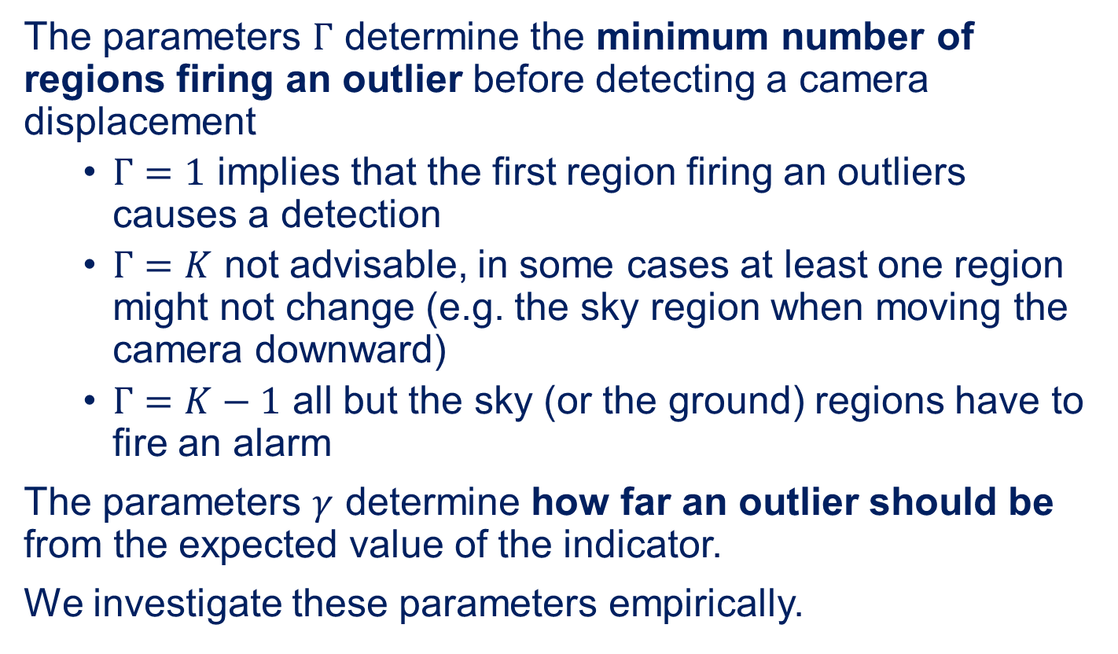
The parameters
The parameters $Γ$ determine the minimum number of regions firing an outlier before detecting a camera displacement
$Γ=1$ implies that the first region firing an outliers causes a detection
$Γ=K$ not advisable, in some cases at least one region might not change (e.g. the sky region when moving the camera downward)
$Γ=K−1$ all but the sky (or the ground) regions have to fire an alarm
The parameters $γ$ determine how far an outlier should be from the expected value of the indicator.
We investigate these parameters empirically.

Slide 32
experiments

Slide 33
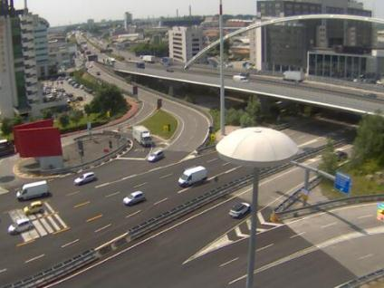

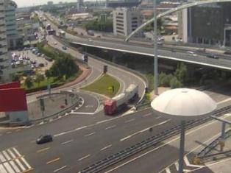
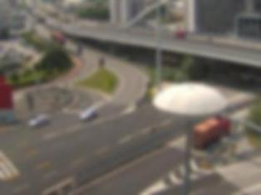
Experiments
8 sequences taken from webcams monitoring different urban areas (more than 12200 frames overall)
Tamper was introduced synthetically in 10% of frames
Normal frame
Displaced frame
Gaussian filter
Blurred frame
Notes:
Potremmo aggiungere un’immagine che illustra come abbiamo generato la sequenza sinteticamente
Sia per il displacement che per il blur, ce la fai?

Slide 34
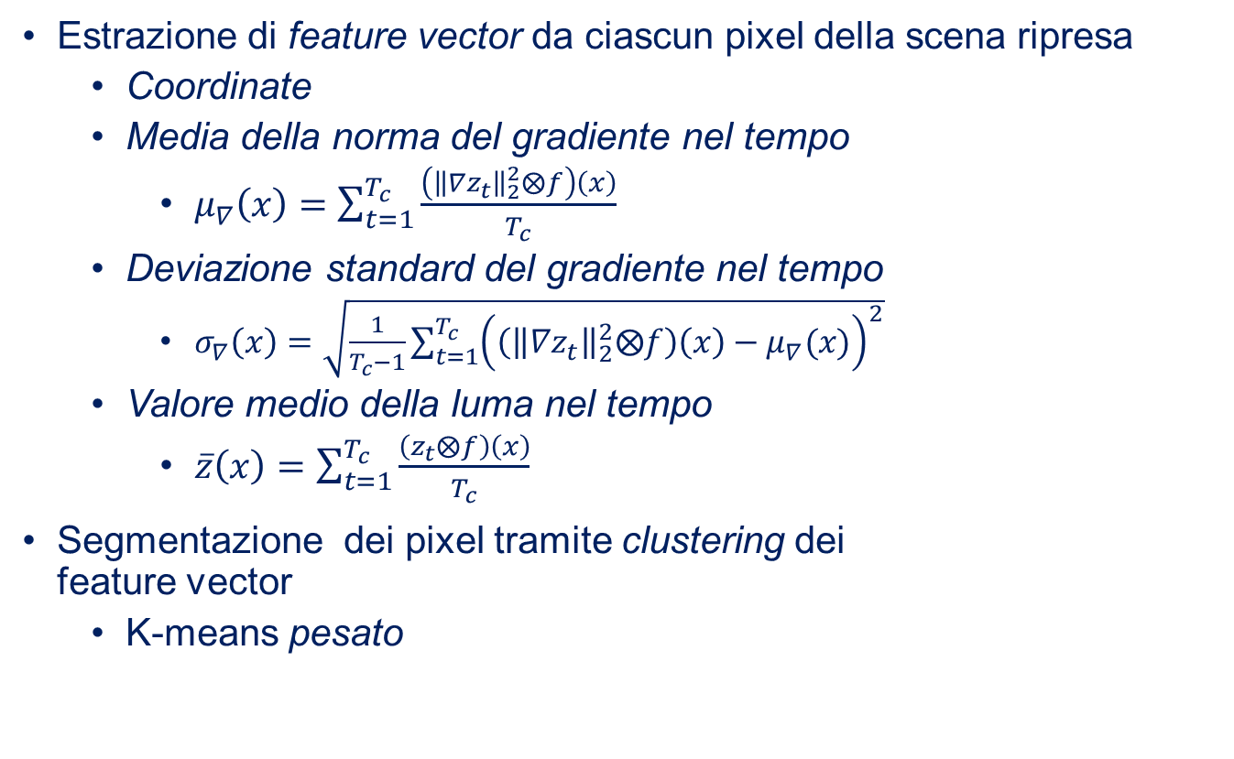
Experiments
8 sequences taken from webcams monitoring different urban areas (more than 12200 frames overall)
Tamper was introduced synthetically in 10% of frames
Different configurations have been compared:
Segmentation vs. whole image
Adaptive regions (Algorithm 1) vs. Voronoi regions
$Γ_{x}=1$vs. $Γ_{x}=K−1$
ROC curves have been computed by varying $γ_{l}$, $γ_{d}$ and $γ_{g}$ between $0.1$ and $50$
Sequences can be provided upon request.

Slide 35
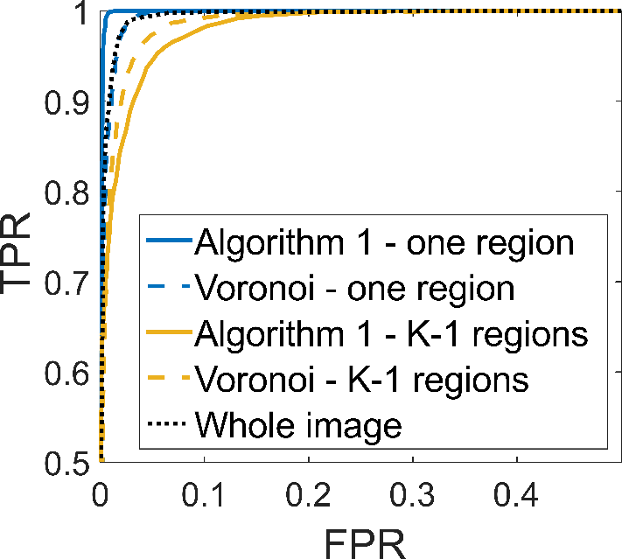
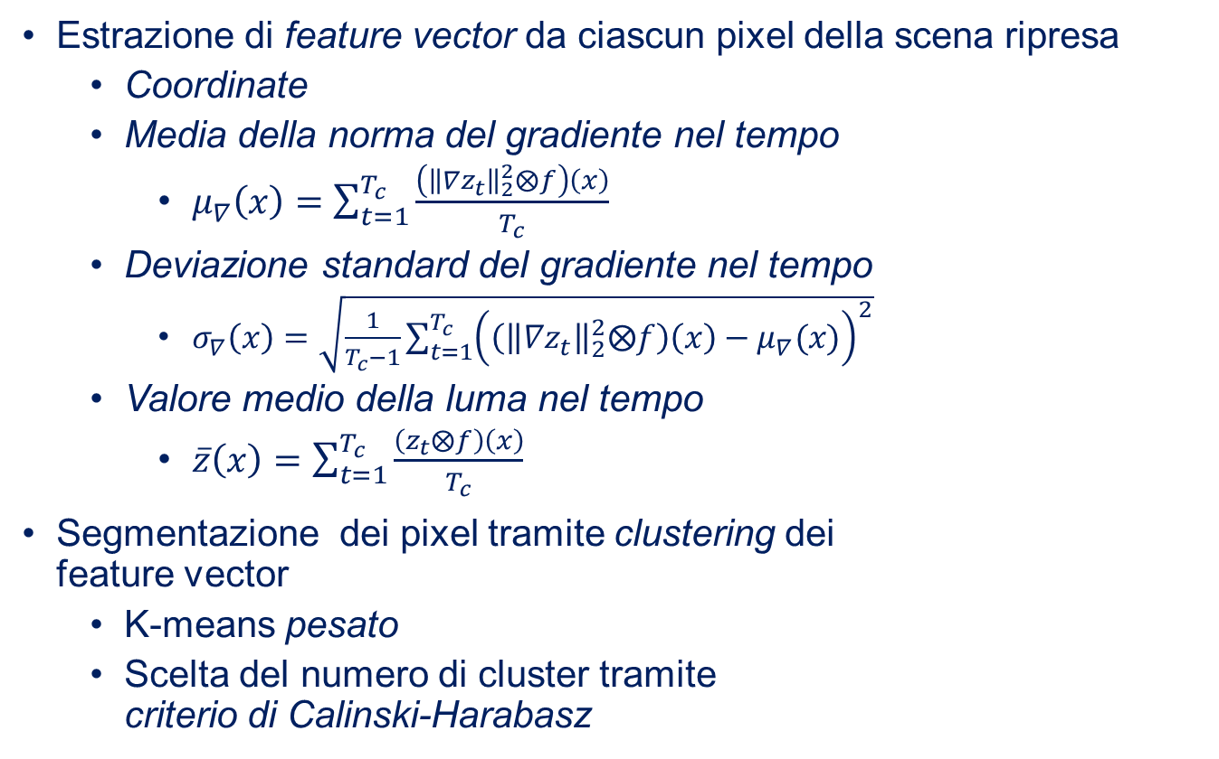

Results
Displacement detection - FD
AUCs:
Algorithm 1 – one region: 99.89%
Whole image: 99.65%
Limiting FPR to $1\%$
Algorithm 1:
$γ_{d}=15.6$
$TPR=99.92\%$
Whole image:
$γ_{d}=6.5$
$TPR=91.67\%$
Voronoi:
$γ_{d}=18.64$
$TPR=89.05\%$

Slide 36
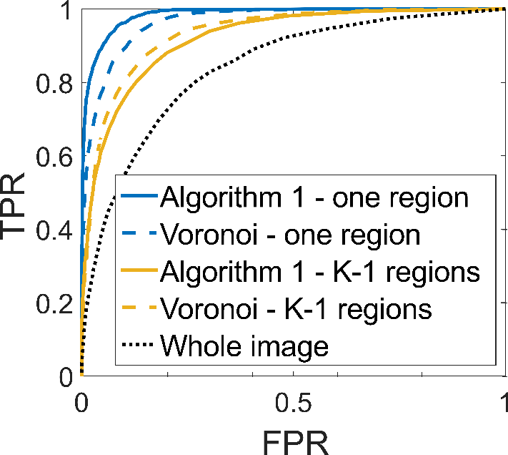
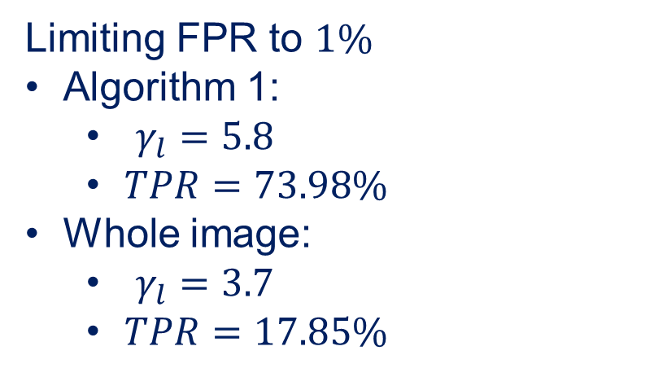
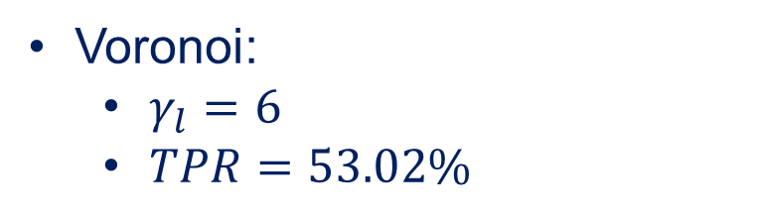
Results
Displacement detection - Luma
AUCs:
Algorithm 1 – one region: 98.44%
Whole image: 84.07%
Limiting FPR to $1\%$
Algorithm 1:
$γ_{l}=5.8$
$TPR=73.98\%$
Whole image:
$γ_{l}=3.7$
$TPR=17.85\%$
Voronoi:
$γ_{l}=6$
$TPR=53.02\%$

Slide 37
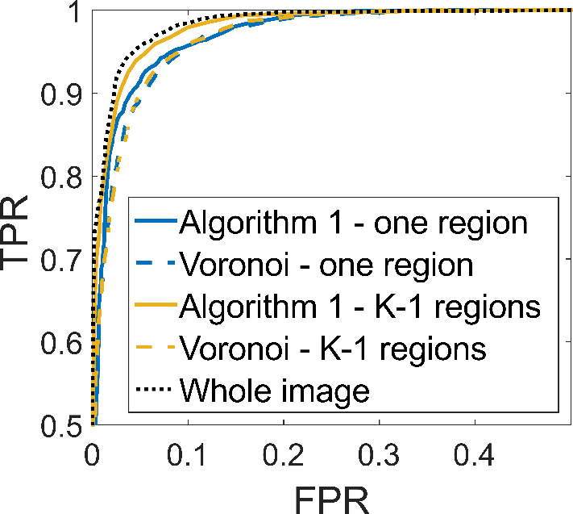
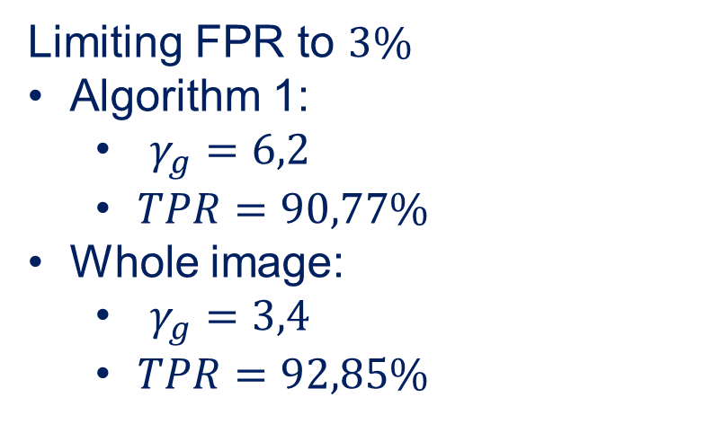
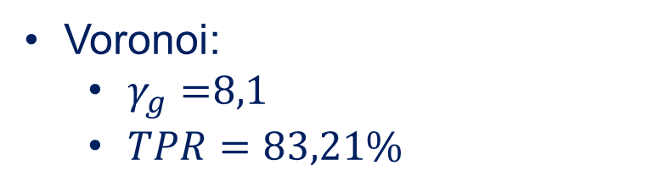
Results
Blurring detection - Gradient
AUCs:
Algorithm 1 – one region: 98.4%
Whole image: 99.13%
Limiting FPR to $3\%$
Algorithm 1:
$γ_{g}=6,2$
$TPR=90,77\%$
Whole image:
$γ_{g}=3,4$
$TPR=92,85\%$
Voronoi:
$γ_{g}=$8,1
$TPR=83,21\%$
Notes:
Limiting FPR to $1\%$
Algorithm 1:
$γ_{l}=9,5$
$TPR=78,1\%$
Whole image:
$γ_{l}=5,4$
$TPR=78,8\%$
Voronoi:
$γ_{l}=12,4$
$TPR=66,46\%$

Slide 38
Results
Camera displacements can be better detected by monitoring FD than luma
But luma requires less computational and memory resources
Blurring is more effectively detected by monitoring the whole image at once
In low-power scenario, it is important to operate at low FPR
Prevent useless data transmission (reduce battery lifetime)

Slide 39
conclusions

Slide 40
Conclusions
Tampering detection for embedded smart cameras
Blur and displacements detection
Operating on image regions improves the detection of camera displacements
Low-computational/memory requirements
Ongoing works:
Approacing other types of tampering
e.g. Degradation of imaging sensor
Integration of sequential monitoring schemes
to detect subtle tampering persisting over time
Investigate superpixels methods to segment the image
exploiting the temporal information in the training sequence

Slide 41
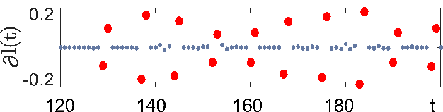
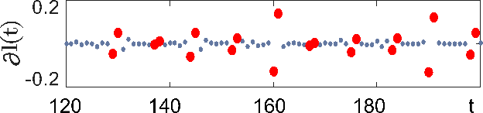
Thanks for your attention! Any questions?

